Slide 1
Rockbuster Stealth LLC

Slide 2
Introduction
Rockbuster Stealth LLC, a former global movie rental chain, confronted by formidable competition from streaming giants like Netflix and Amazon Prime.
Strategy shift towards leveraging existing movie licenses to inaugurate an online video rental service, aimed at maintaining competitiveness in the evolving market landscape.

Slide 3
Key Questions
Where are our customers located?
What is the average rental duration?
Which genres are most profitable?
Which movies are most profitable?
In which cities is our profit highest?
Who are our top customers?

Slide 4
Our Stat overview
Rental Duration
Average: 5 days
Max: 7 days
Min: 3 days
Replacement Cost
Average: 19,98 $
Max: 29,99 $
Min: 9,99$
Length
Average: 115 min
Max: 185 min
Min: 46 min
Rental Rate
Average: 2,98 $
Max: 4,99 $
Min: 0,99
Number of Countries: 109
Number of Customers: 599
Languages: 1
Number of Movies: 1000
Number of Genres: 17

Slide 5
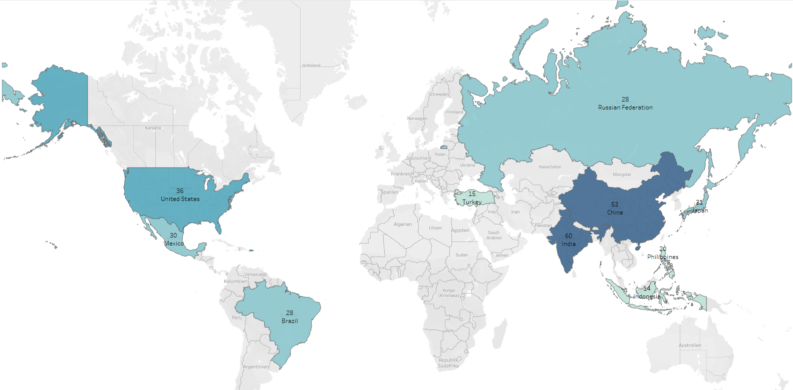
Where are our customers located?
The countries with the most customers are:
India
China
United States
Japan
Mexiko
Brazli
Russian Federation
Philippines
Turkey
Indonesia

Slide 6
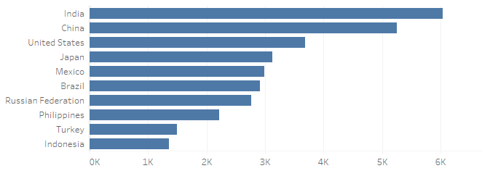
Revenue for the top 10 countries
The countries with the highest revenue are:
India
China
United States
Japan
Mexico
Brazil
Russian Federation
Philippines
Turkey
Indonesia

Slide 7
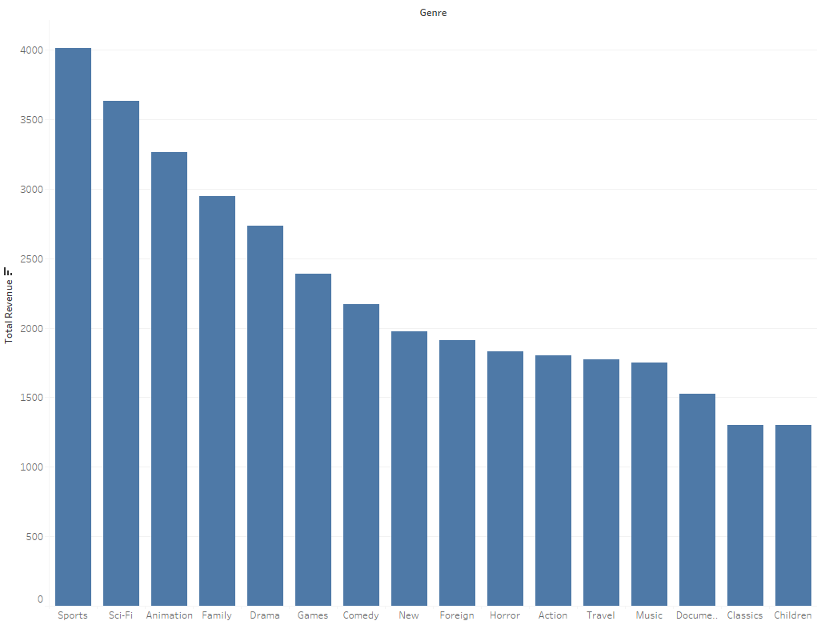
Which genres are most profitable?
The most profitable genres are:
Sports
Sci-Fi
Animation
Family
Drama

Slide 8
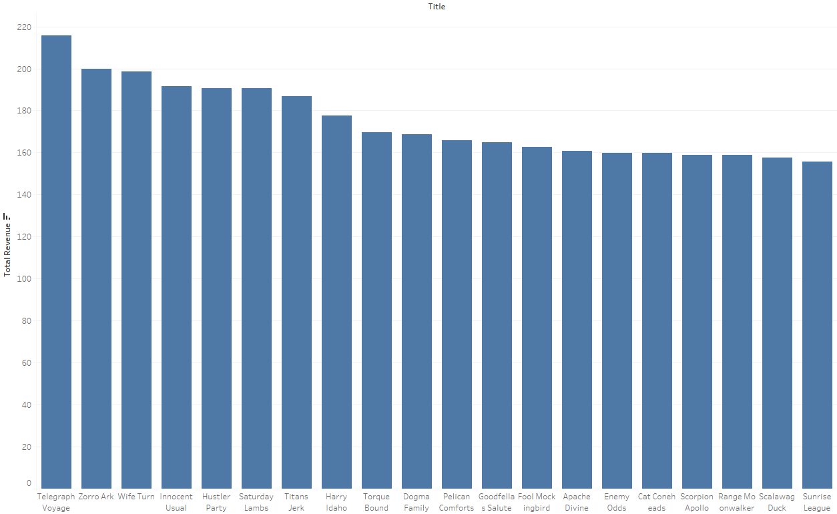
Which movies are most profitable?
The most profitable movies are:
Telegraph Voyage
Zorro Ark
Wife Turn
Innocent Usual
Hustler Party
Saturday Lambs

Slide 9
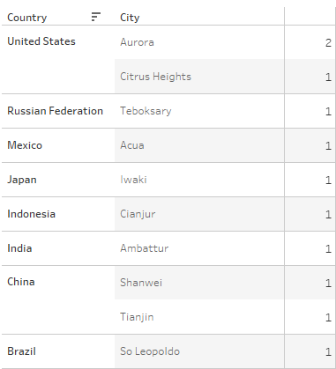
What are our Top Revenue Cities and the amount of residing customers?

Slide 10
Who are our top customers?
Arlene Harvey
Ambattur, India
111,76 $
Kyle Spurlock
Shanwei, China
109,71$
Marlene Whelch
Iwaki, Japan
106,77 $
Glen Talbert
Acua, Mexiko
100,77 $
Betty White
Citrus Heights, United States
96,77 $

Slide 11
Summary
Our #1 Region is Asia
Our Top 3 Markets are India, China and USA
Our Top 3 genres are Sports, Sci-Fi and Animation
Our #1 Movie is Telegraph Voyage

Slide 12
Recommendations
Focusing on the top region Asia
Don’t overlook the USA, since it’s our third most profitable country
Price adjustments, depending on sales numbers
Focus on profitable genres Sport, Sci-Fi and Animation
Further analysis
It seems like our top customers may be English natives regardless of location - catering towards the Asian market could be risky and needs more research

Slide 13

thank you for your attention

